Slide 1

Customer Segmentation
Dimensionality Reduction and Clustering Techniques

Slide 2


Goal of the project and Steps
Goal of the project:
Clustering the customers of a wholesale shop basing on their annual spending on the products, divided per categories: Fresh, Milk, Grocery, Frozen, Detergents Paper, Delicatessen.
Steps:
1. Data exploration and pre-processing.
2. Dimensionality reduction.
3. Applicaton of clustering techniques.
Dataset: https://archive.ics.uci.edu/ml/datasets/Wholesale%2Bcustomers

Slide 3
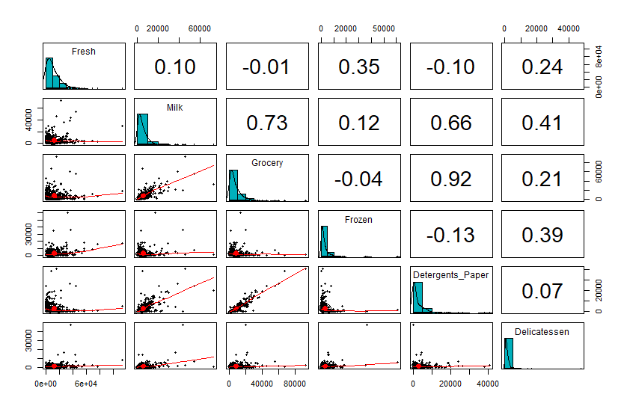
1.1. Data exploration and pre-processing
Notes:
The distribution of each variable is shown on the diagonal.
On the bottom of the diagonal : the bivariate scatter plots with a fitted line are displayed
On the top of the diagonal : the value of the correlation

Slide 4
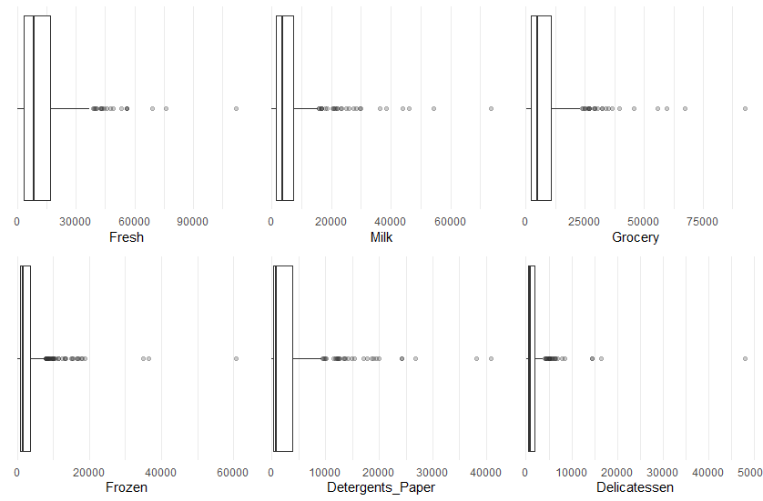
1.2. Data exploration and pre-processing
Data
Skewed to the right.
Correlation between variables.
Presence of ouliers.

Slide 5
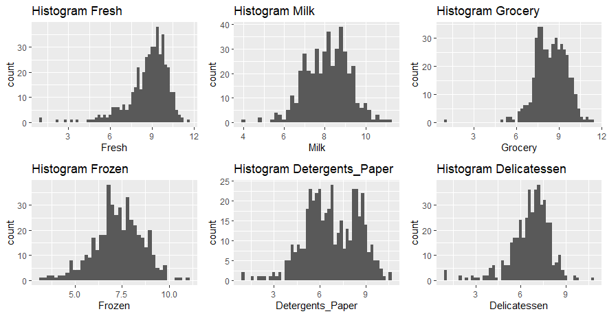
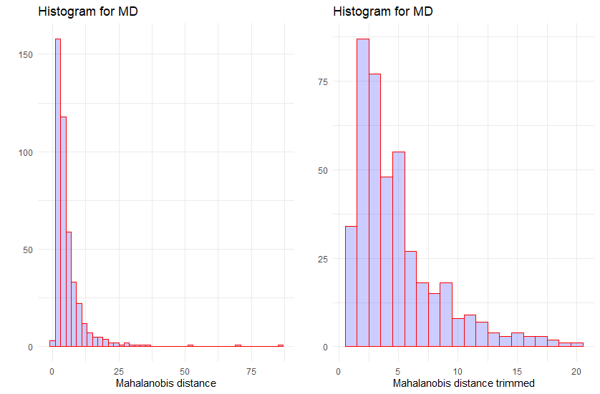
1.3. Data exploration and pre-processing
Reduce skewness
Logarithmic transformation
Mahalanobis distance + Trimming
Outliers
Notes:
The inclusion of outliers is usually signaled by a sudden change in Mahalanobis distances and a more gradual change in parameter estimates.
The Mahalanobis distance between two n-dimensional points is the distance scaled by the statistical variation in each component of the point.
Customers that have a value of the MD distribution outside the range between the quantiles of order 0.15 and 0.85 are excluded from this analysis, because they represent particular cases that could influence the clustering analysis.

Slide 6
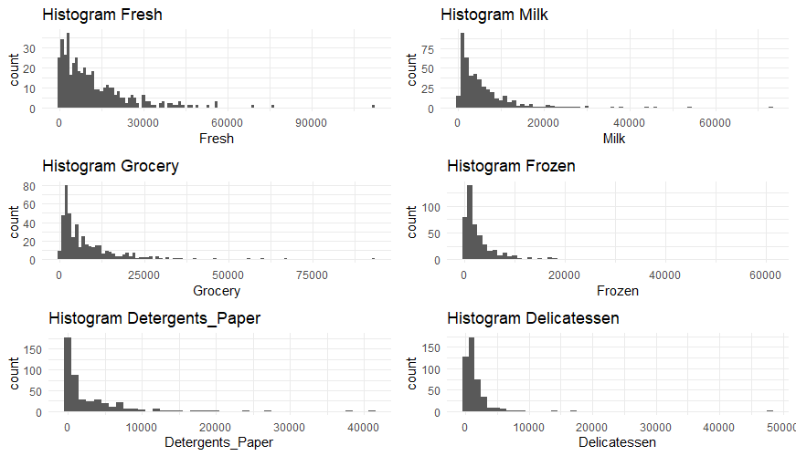
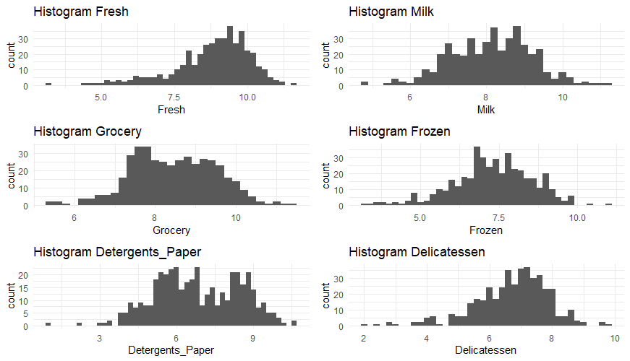
1.4. Data exploration and pre-processing
ORIGINAL DATA
POST-PROCESSING DATA

Slide 7
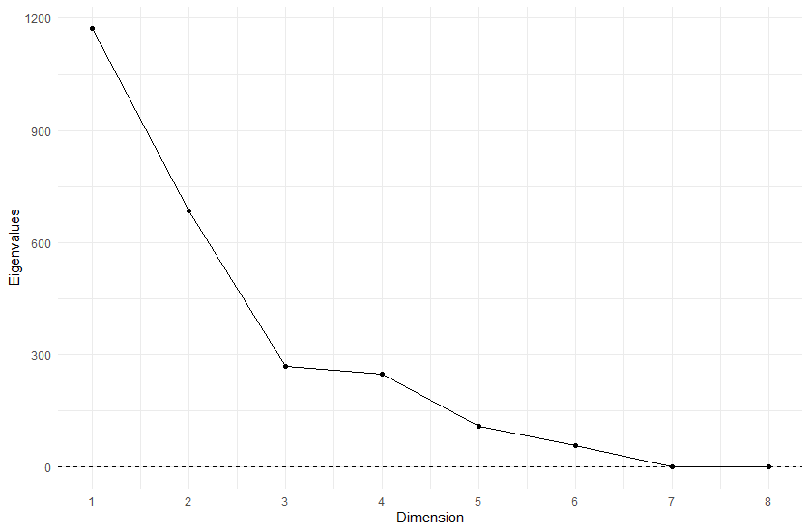
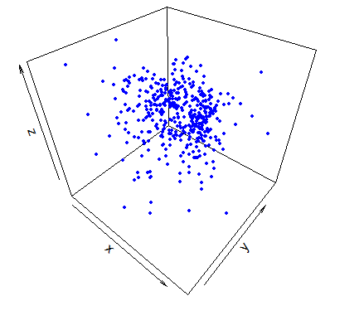
2.1. Dimensionality Reduction
Multidimensional Scaling
Notes:
MDS aims at geometrically representing observations in a two-, three or multi-dimensional space having has input the proximity matrix the represents the distance between the points.
Distance can be Euclidean, Manahattan, Mahalanobis. In this case I applied the classic MDS with Euclidean distance.
B matrix is eigen decomposed

Slide 8
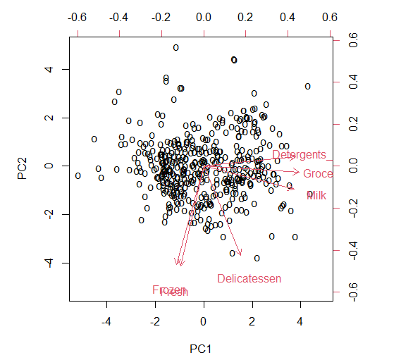
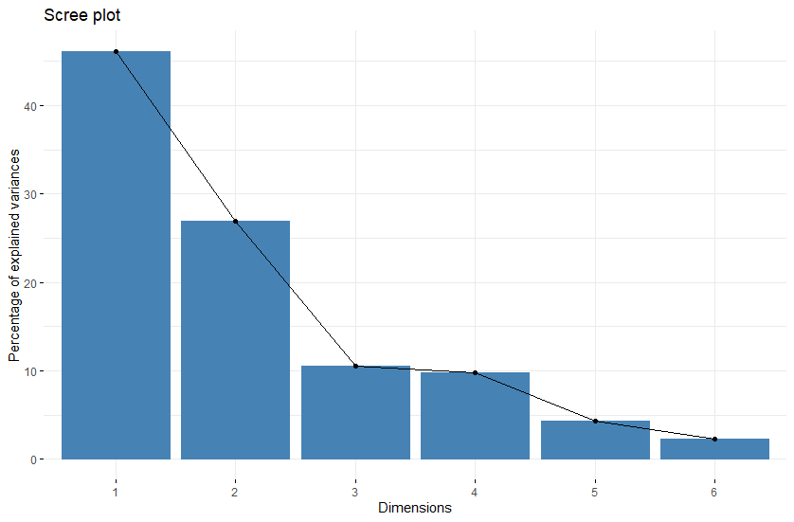
2.2. Dimensionality Reduction
Principal Components Analysis
Notes:
The aim of PCA is to find an optimal linear combination of the original variables X1, . . . , Xp and retain as much variance as possible from them.
This means: z1 = Xa1 and Var(z1) = max.
We have that Var(z1) = aSa, where S is the variance-covariance matrix of matrix X.
we get: Sa1 = λ1a1 = 0 i.e., the vector of coefficients a1 is an eigenvector of matrix S (in output from lagrangian maximization) related to the highest eigenvalue (for the first component)
Second component must be uncorrelated
The PC scores are the new coordinates of the original observations with respect to the principal components (i.e. the observations represented in the new coordinating system).
And the Loadings: Their project values on each PC show how much weight they have on that PC

Slide 9
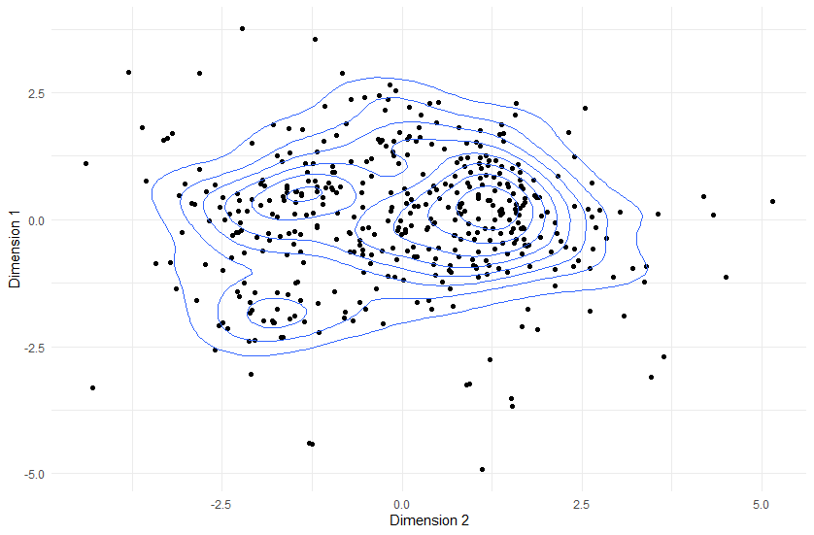
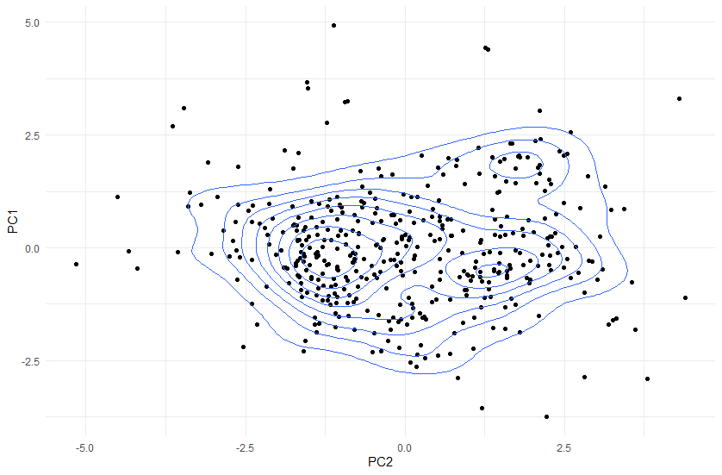
2.3. Dimensionality Reduction
Comparison MDS and PCA

Slide 10
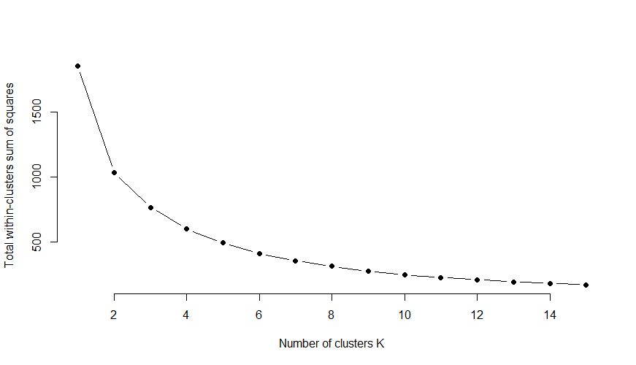
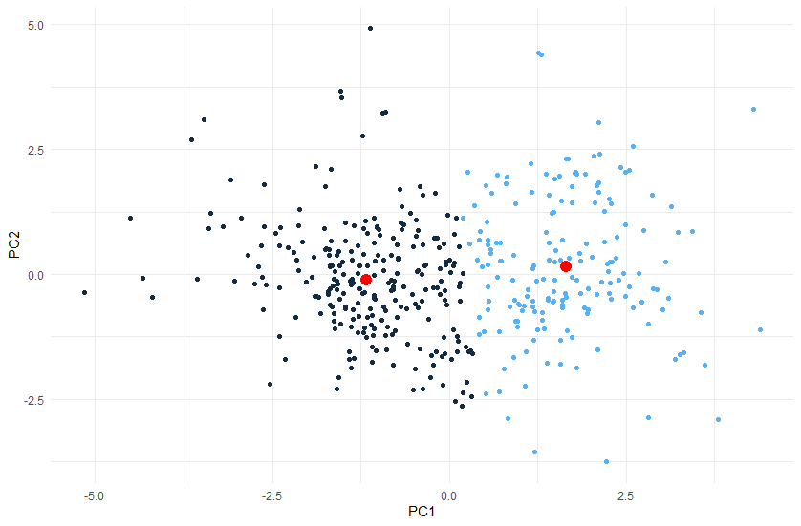
3.1. Clustering
Elbow method and K-mean Clustering
Notes:
Whitin cluster variation that is the average (Euclidean) distance between all cluster members

Slide 11
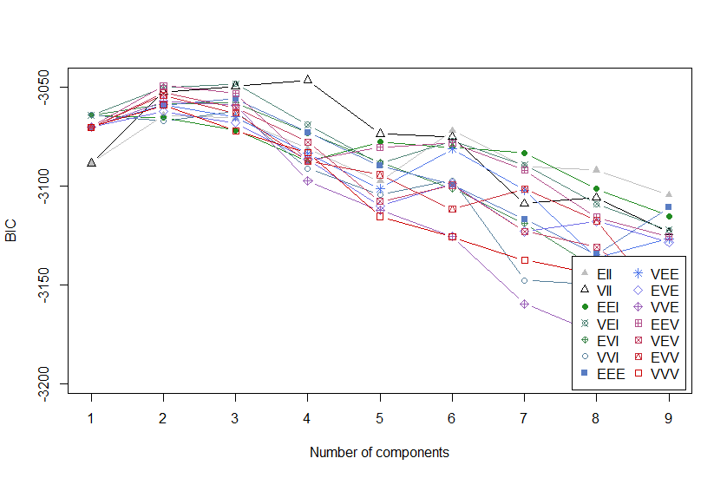
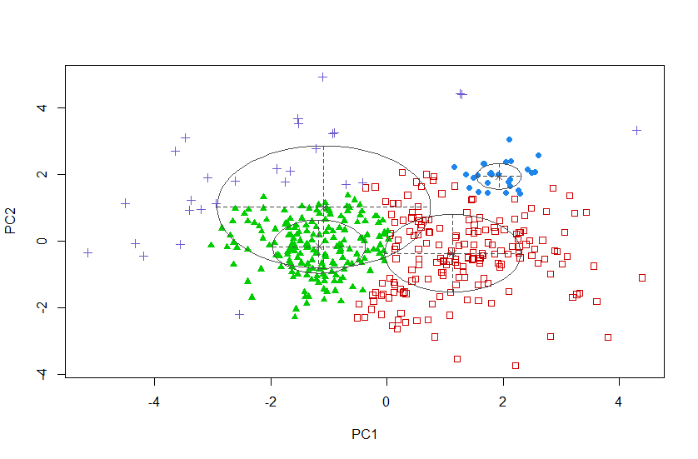
3.2. Clustering
Model selection and Model-based approach
Notes:
BIC = Bayesian information criterion: BIC = -2ln(L) + k ln(n)
VII stands for "varying volume, round shape
eigenvalue decomposition of the group variance-covariance matrix Σg: Σg = λgDgAgD0g . (Volume-shape-Orientation)
Orientation = matrix of eigenvectors
Shape = matrix of eigenvalues
Volume = constant lamba
If we have Ag = diag{A1,g, . . . , Ad,g} and we have A1,g A2,g > then then the gth mixture component is tightly concentrated around a line in Rd.
If A1,g ≈ A2,g > A3,g, this means that the gth mixture component is tightly concentrated around a two-dimensional plane in Rd.
If all the values of Aj,g are approximately equal, then the gth mixture component is roughly spherical.
Robust clustering: k-medians method (single outliers)
Trimmed k-means method

Slide 12



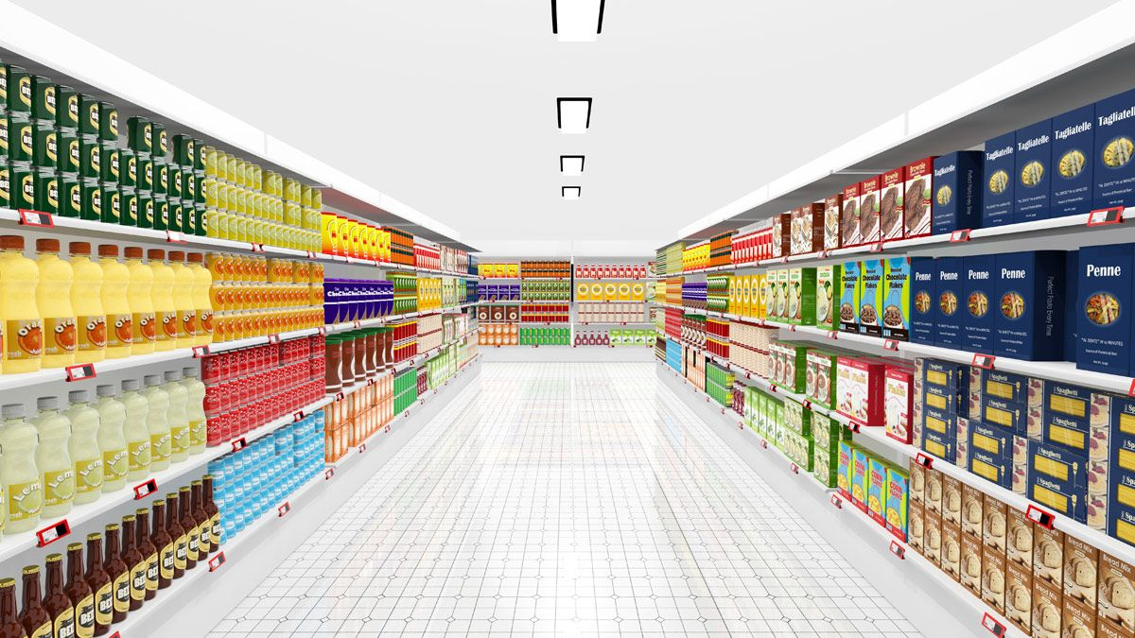
Conclusion

